Slide 1
Business Proposal Jenndale A. Merza

Slide 2

Business Proposal
POGI SOFT.

Slide 3
What is POGI SOFT.?
The POGI SOFT is the latest centralized website developer in the country today
It is a centralized web company that incorporates e-commerce websites for advertising and marketing within the National Capital Region(NCR) in partnership with the Department of Tourism.
The company is designed to bridge the gap in effectively promoting and advertising established and potential tourist destinations as well as the products and services offered by different business firms in the NCR.

Slide 4
Problems addressed by the Company
There is no centralized website in the NCR that serve as a portal where in tourists and people of NCR can use to locate and choose from different tourist destinations, products as well as services offered and provided by different business firms.
2) Individual business website in NCR has less chance to be visited, thus less chance of generating income.

Slide 5
Solutions
Building a centralized website with GIS application that will help different business firms in the NCR in effectively promoting and advertising tourist destinations, products and services in which the POGI SOFT. adheres to do.
The POGI SOFT. is in partnership with Department of Tourism making the website a web spot for tourism in the NCR. The Department of Tourism will be providing leaflets containing the website information. The leaflets will be given in the areas like airports and sea ports for them to visit the sites that will serve as “tool guide” all throughout their visitation.

Slide 6
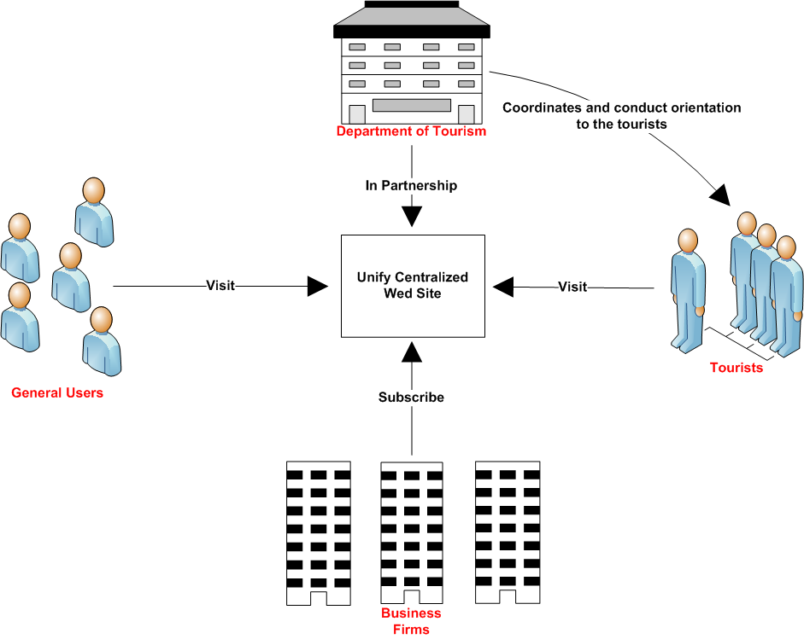
Figure 1.0 Shows how the system
works
POGI SOFT. CENTRALIZED WEBSITE

Slide 7
FEATURE-BENEFIT TABLE
FEATURE | BENEFIT/S
Centralized Website | Effectively advertise business products and services
GIS Application | Visually locate the business or tourist spot
Supported by Department of Tourism (DOT) | Help to gain popularity and hence increase profit

Slide 8
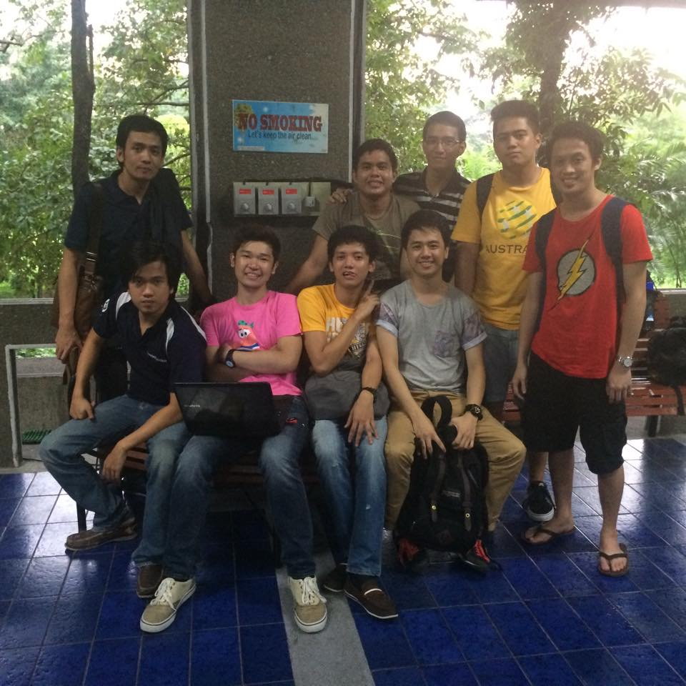
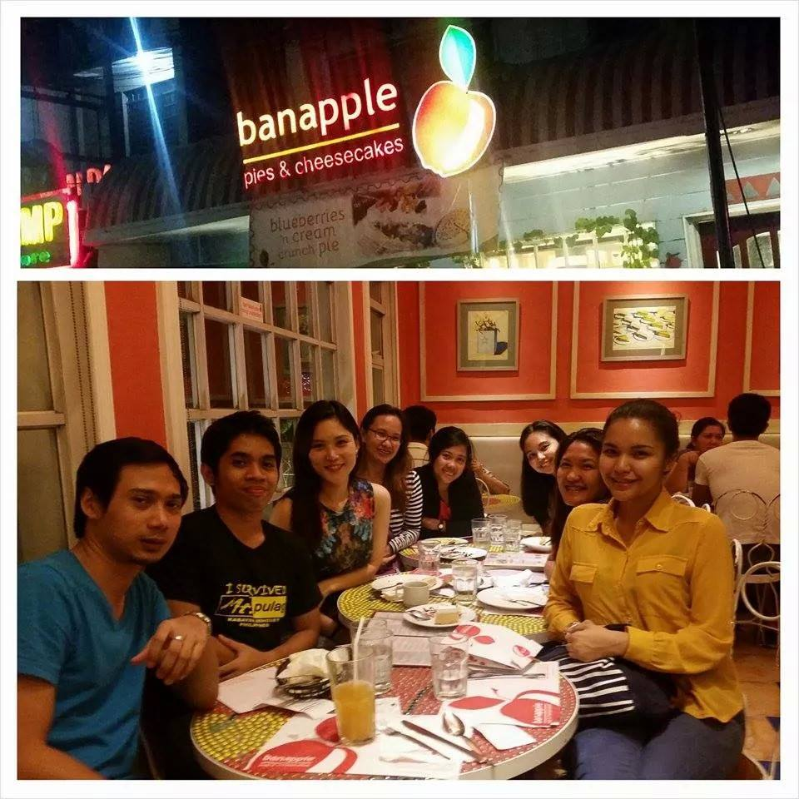
Target Market
Tourists
NCR People

Slide 9
Customers
Business firms in the NCR with or w/out existing websites
Tourists Spot Owners with or w/out website

Slide 10
Company Status
Latest centralized website developer in the country today
Equipped with Information Technology Professionals, expert in different IT fields
In partnership with the Department of Tourism
Company is in its way in promoting its business and convincing business firms to tie up with the company

Slide 11
Business Model and Marketing Plan
The company will develop a centralized website and from that, the company will convince business firms and tourists spot owners to tie up with the company and advertise their products and services as well as the tourists destination on the internet
The company will generate income/revenue out from the business firms who made a subscription in the system.

Slide 12
Business Model and Marketing Plan
The life span of advertising and promoting the product and services will depend on the subscription basis of the business firms in the company

Slide 13
Subscription Basis and Pricing Model
Subscription Type | Subscription Rate
Monthly | ₱ 1,350.00
Quarterly | ₱ 4,050.00
Annually | ₱ 5,400.00

Slide 14
Subscription Basis and Pricing Model
First Year Budget | Cost
Salaries | ₱ 810,000.00
Maintenance | ₱ 360,000.00
Local Advertising | ₱ 225,000.00
Marketing | ₱ 540,000.00
Accounting and legal | ₱ 238,000.00
Rent | ₱ 477,000.00
Internet and Telephone | ₱ 44,000.00
Domain Name | ₱ 2,250.00
Total | ₱ 2,697,705.00

Slide 15
Thank you!

